Slide 1

Virtual Roll Call 4.0
Team Members: Darilys Pereira Lopez, Juan Hernandez Product Owner: Jason Cohen, Frank Alvarado
Instructor: Masoud Sadjadi School of Computing and Information Sciences Florida International University
Final Presentation
Spring 2018
Notes:
7 seconds.( I will select 2 best slides (i will give them extra points and students will present for CIS committee)
Greet your audience, thank them for attending your presentation, introduce yourself, introduce your project, introduce your team members, and quickly indicate what each of you did in a high-level manner, and put more emphasis on your part/contribution.

Slide 2
Project definition
Roll call is a briefing meeting in police departments where shift supervisors share critical information with officers.
Officers cannot always be present for these briefings, preventing them from receiving vital information.
It can be difficult for supervisors to distribute new material to officers after roll call is over
Notes:
10 seconds.
Introduce the problem that the whole project (in all versions) tackles with GIF or screenshot.

Slide 3
Solution
The Virtual Roll Call (VRC) web application solves the following problems:
Eliminates the need for in person roll calls
Allows officers to receive information in real-time
Verifies that officers have reviewed required documents
Notes:
20 seconds.
Introduce the problem that the your project (in new version) tackles with GIF or screenshot.

Slide 4
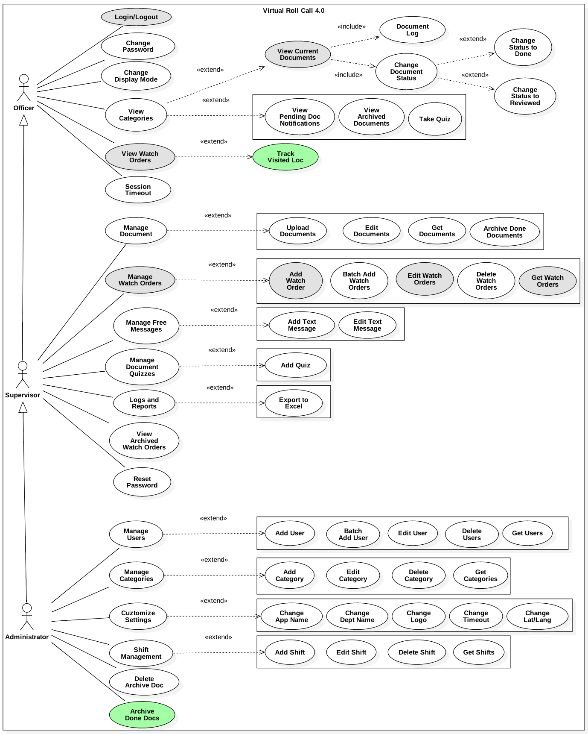
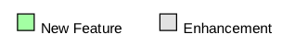
Requirements: Use Cases
Notes:
5 seconds
Show the Use Case Diagram for the whole project. Highlight your use cases.

Slide 5
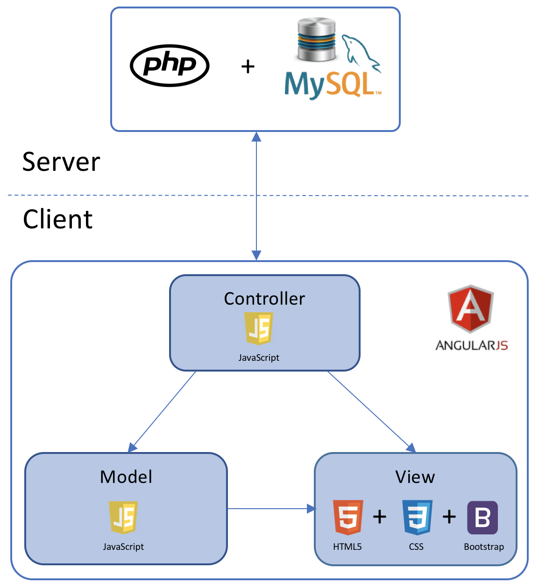
System Design: Architecture
Model-View Controller
Model-View-Controller is an architectural pattern commonly used for designing web applications. As the name implies, there are 3 major components in the architecture:
Model – manages the data and logic of the application
View – The User Interface of the application
Controller – Receives user input and modifies data in the model
Client-Server Model
Our system uses the Client-Server model, which is an application structure used in distributed applications. The client makes requests to the server via the internet,and the server responds to the client with the requested function. Virtual Roll Call is hosted on a Windows Server, and clients are able to use the application and perform actions through the server.
Notes:
20 seconds
System design: Highlight the parts that you contributed to them.
1. System decomposition; identify the architecture patterns used
2. System deployment – h/w and s/w requirements

Slide 6
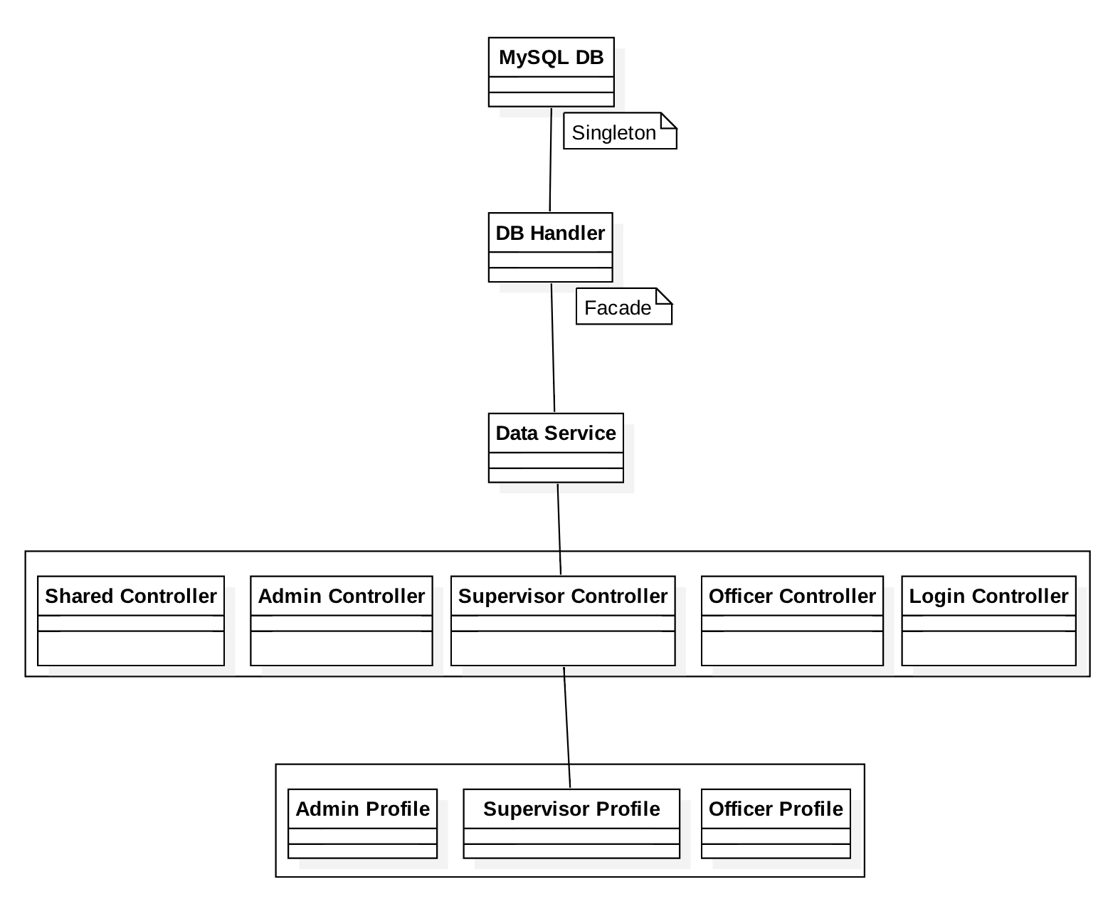
Minimal Class Diagram
Notes:
10 seconds.Minimal class diagram. Highlight the classes that you created/modified
Identify the design patterns used (one or more slides).

Slide 7
User Stories
User Story 331: Keep Track of Visited Location
User Story 330: Add Additional Fields to Watch Order to Match the Original Document and Allow Officer to See them on Map
User Story 336: Improve User Login
User Story 341: Archive Only “Done” Documents
User Story 342: Open Document Viewer has to be Defaulted to Fit to Screen
Notes:
5 seconds.
List the user stories that you worked on them.(put in order of importance). Stay focused on the parts that you have been working.

Slide 8
User Story #331
Keep Track of Visited Location
As an officer, I would like to track the locations I visited so it can help me identify the locations I haven’t been at.
Acceptance Criteria:
Provide the ability to the officer to mark and unmarked locations in the View Watch Order screen grid.
Provide a button to unmark all.
Save changes so that when officer logs out and logs back in, his/her locations are marked as them left them.
Notes:
60 seconds
The tile of user story
The most important user story you worked on it. You have to describe this one very well and be proud of that.
Please present and show the complexity of your work, code, algorithms, and technical challenges and technologies you have used. (you could use screenshot if you want. Visual presentations are better than text presentation)
Go into the details of the most important/significant tasks using bullet lists or visual graphs or state chart diagram
Sequence Diagram for this user story is mandatory (in another separate page if required)
Demo using screenshots or GIF (in another separate page if required)

Slide 9
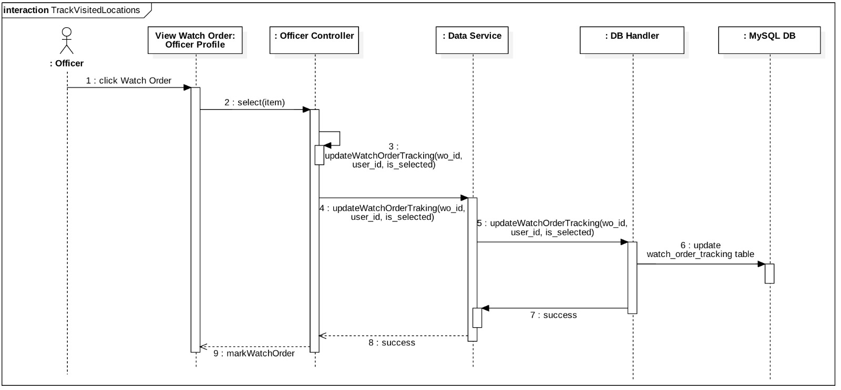

Slide 10
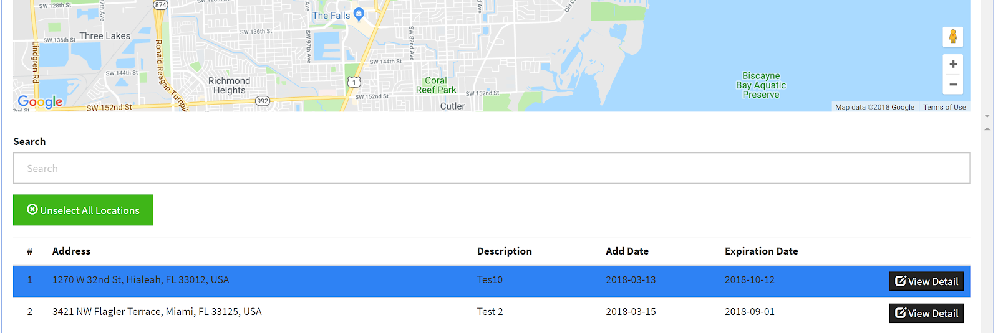

Slide 11
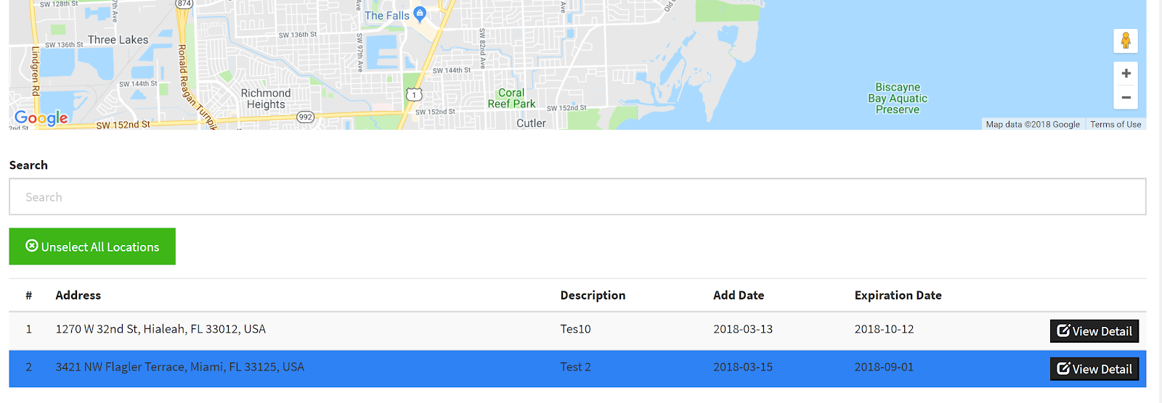

Slide 12
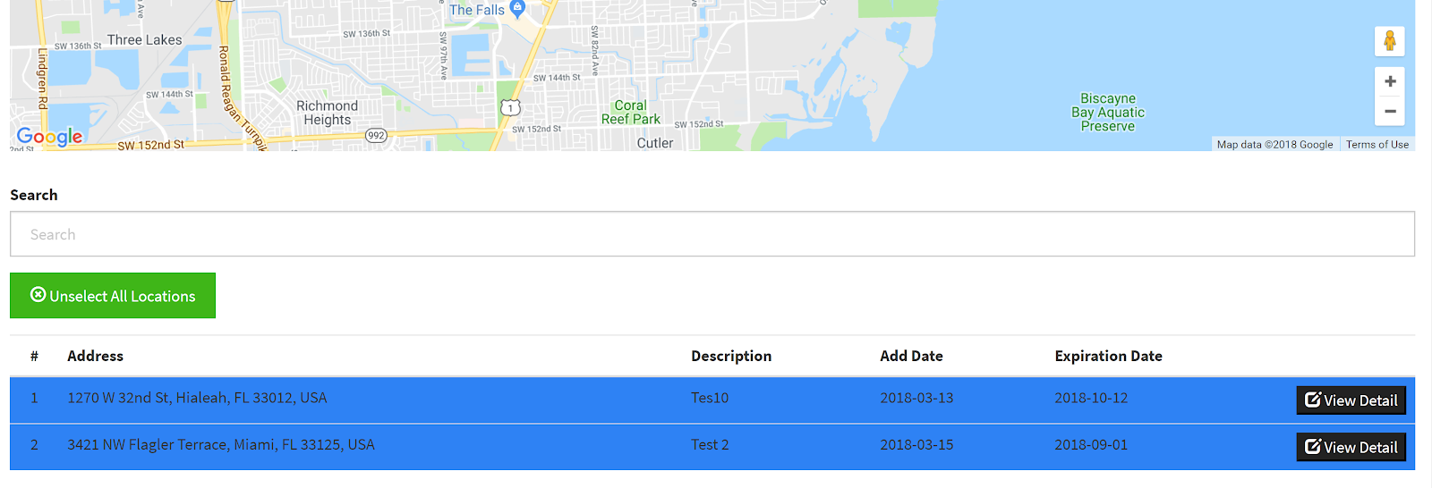

Slide 13
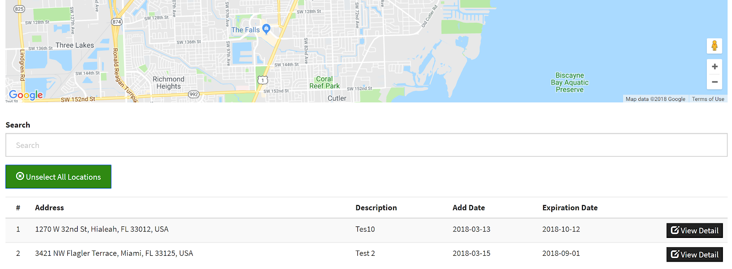

Slide 14
User Story #330
Add Additional Fields to Watch Order to Match the Original Document and Allow Officer to See them on Map
As a supervisor, I would like to add more fields to the watch order input screen so that it matches the original document and allow officers to see them on map.
Acceptance Criteria:
Add an button to the grid where all the watch order are been shown to officers so they can see full details of the watch orders.
Show who created document.
Add required info to the context menu of the marker in the map
Add additional fields to watch order input form to match the original paper watch order the police department currently uses.
Required fields: address, start date, person requesting watch order, emergency contact (with checkbox to specify that is the same as requester), prepared by (logged person)
Check box to allow the contact information to be replicated into the emergency contact.
Notes:
20 seconds
The tile of user story
Please present and show the complexity of your work, code, algorithms, and technical challenges and technologies you have used. (you could use screenshot if you want. Visual presentations are better than text presentation) - Go into the details of the most important/significant tasks using bullet lists or visual graphs or state chart diagram - Demo using screenshots or GIF (in another separate page if required)
Sequence Diagram for this user story is optional

Slide 15
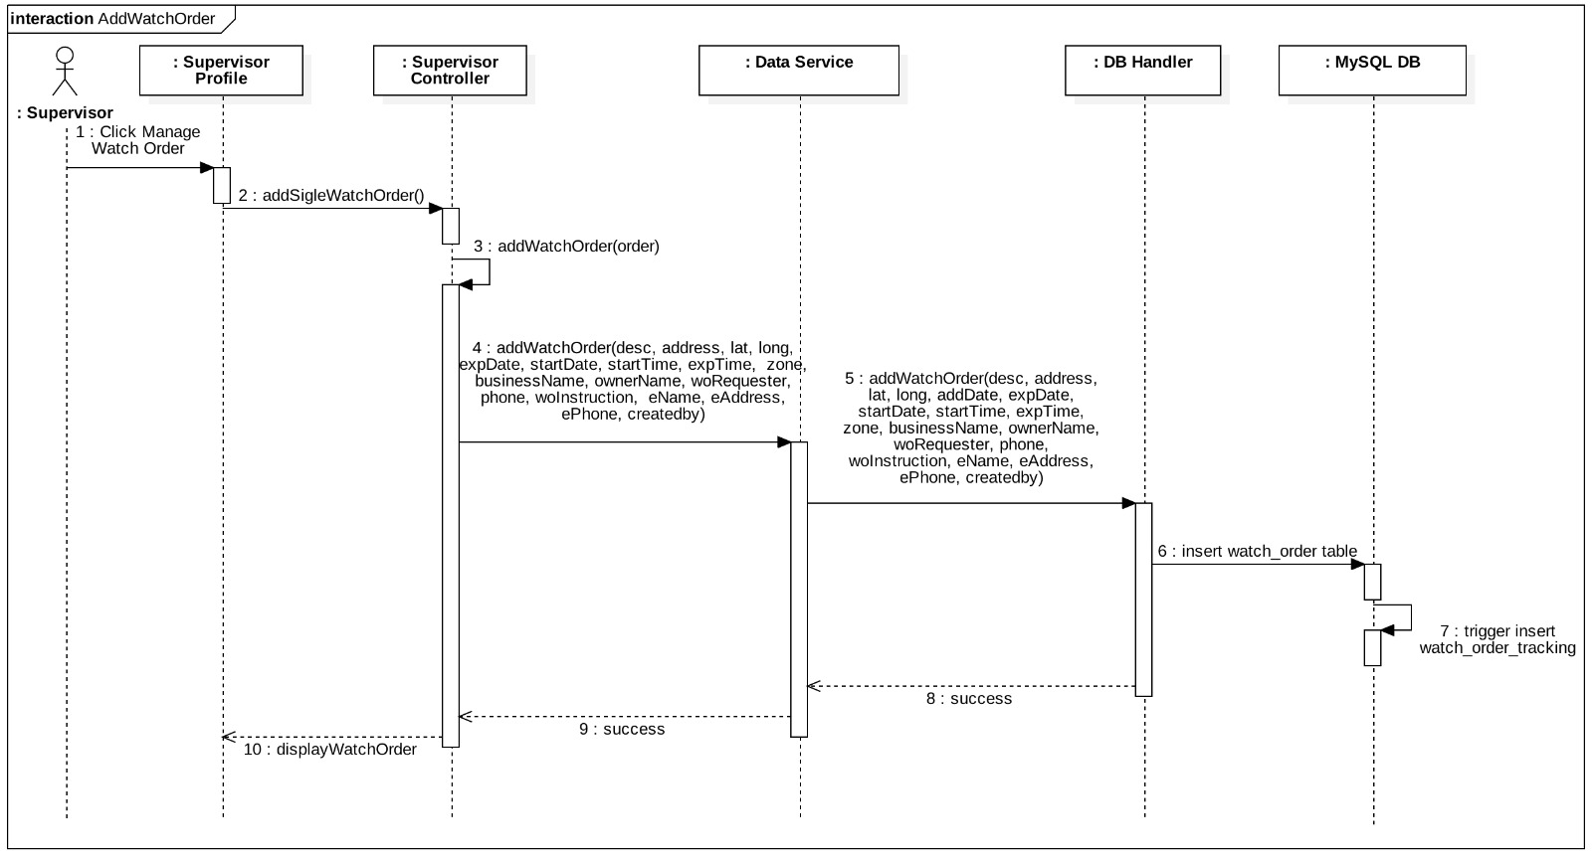

Slide 16
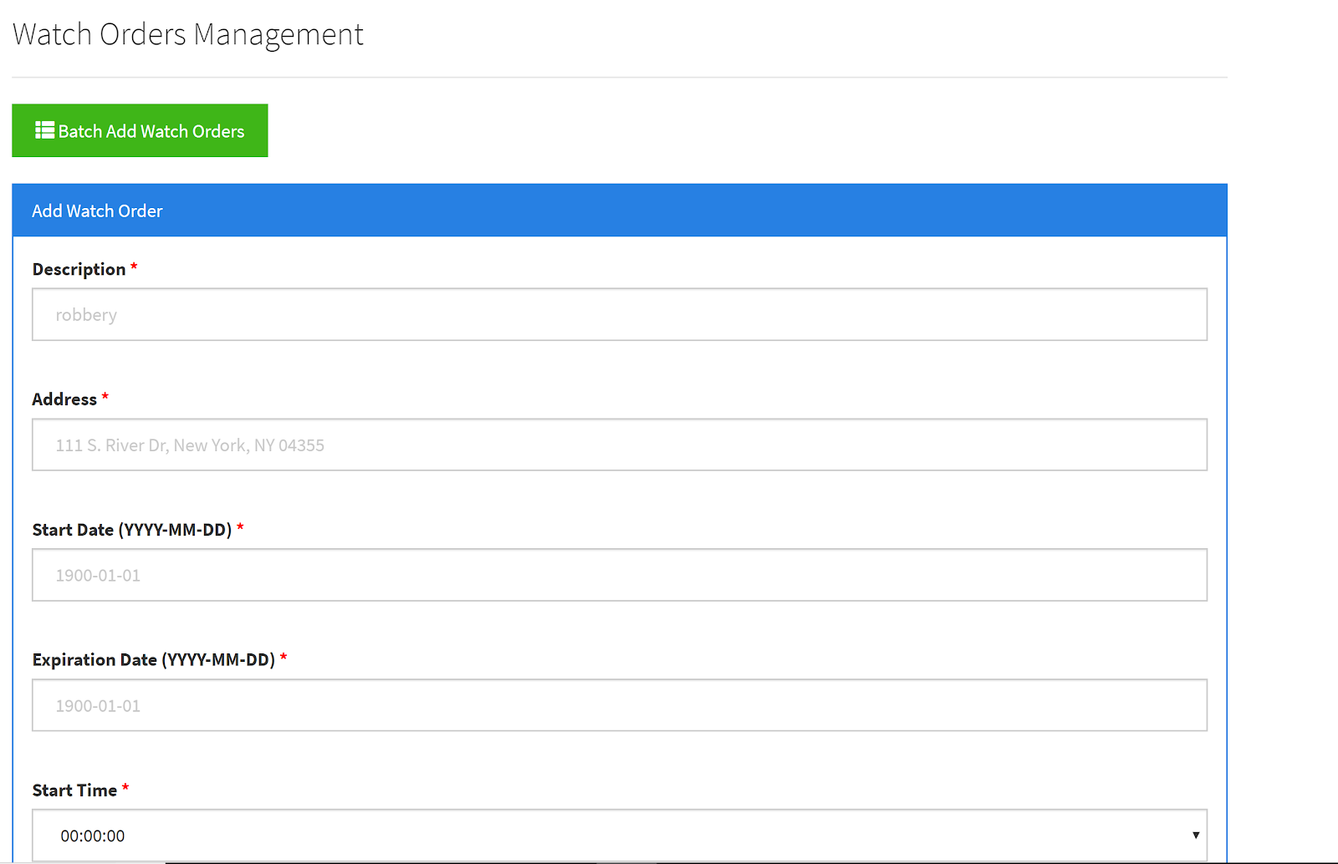

Slide 17
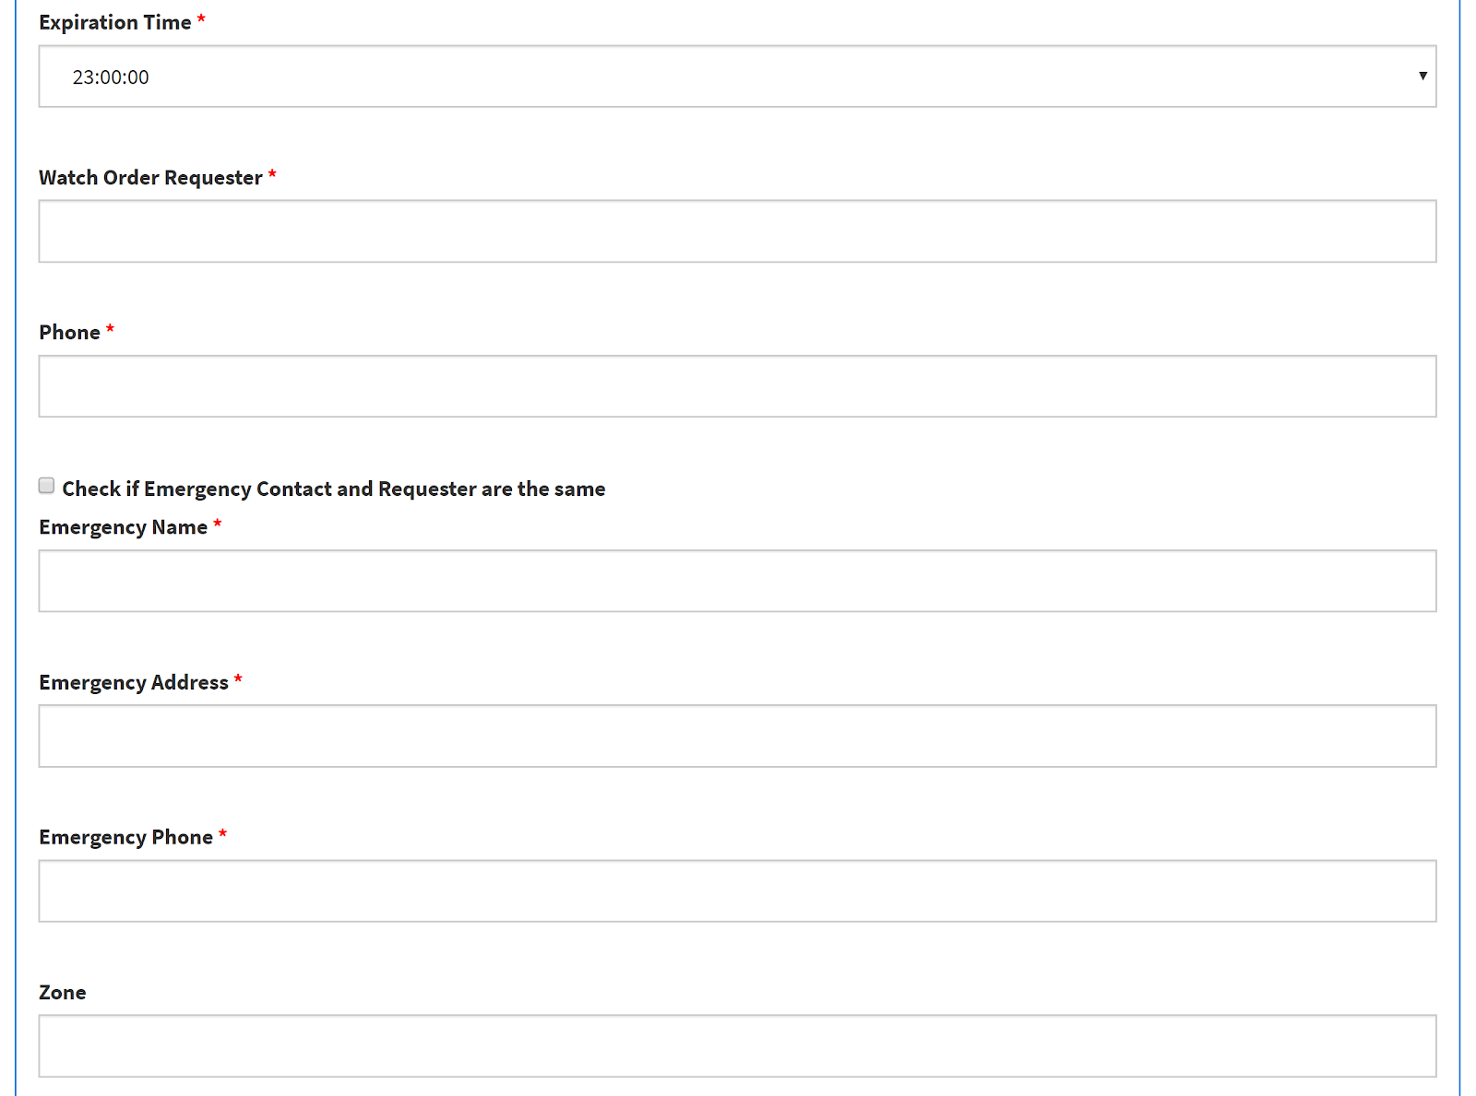
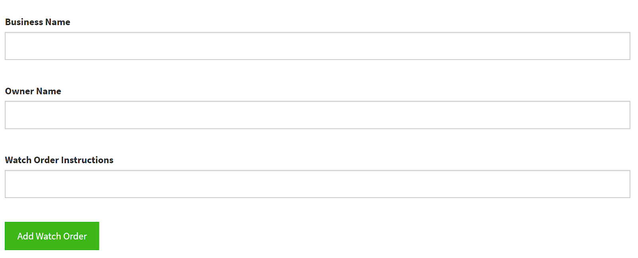

Slide 18
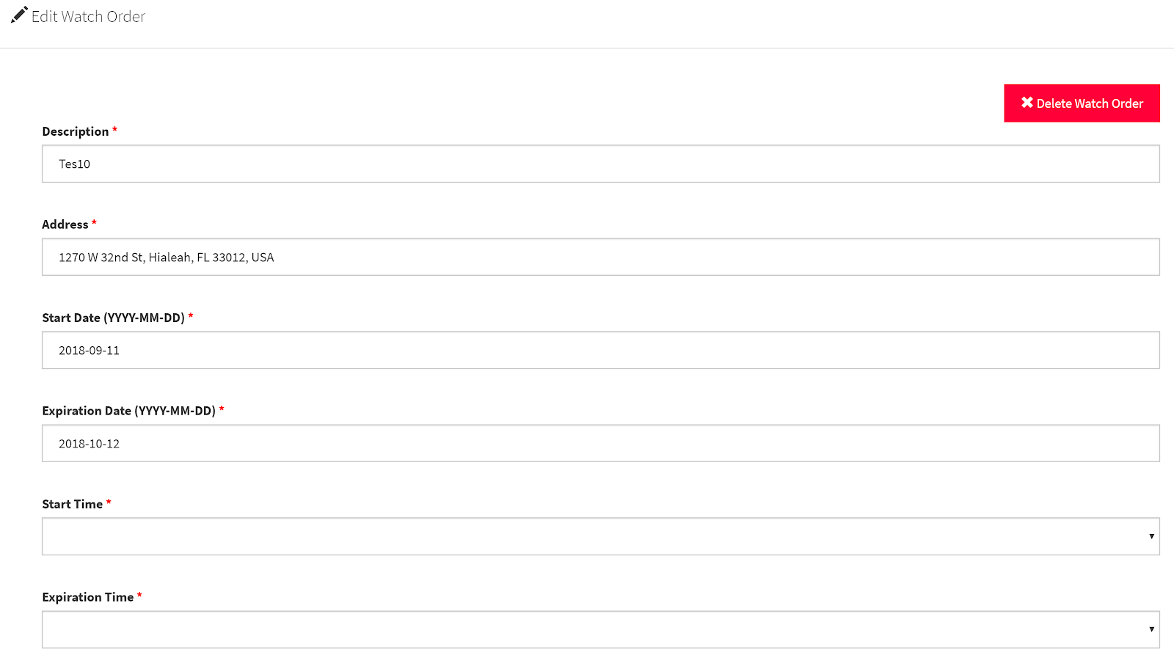
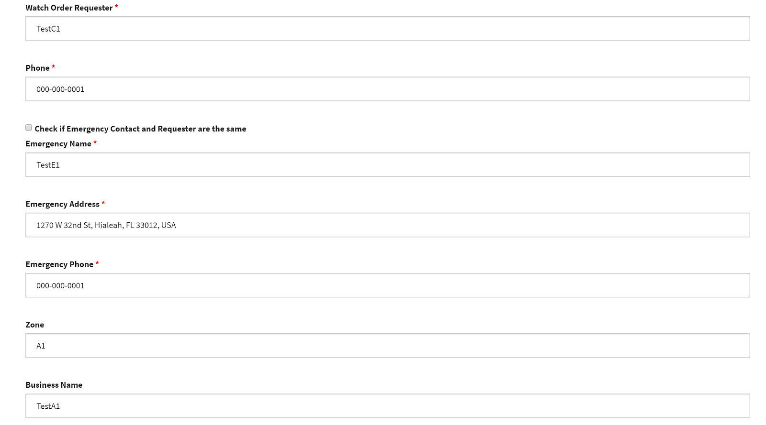
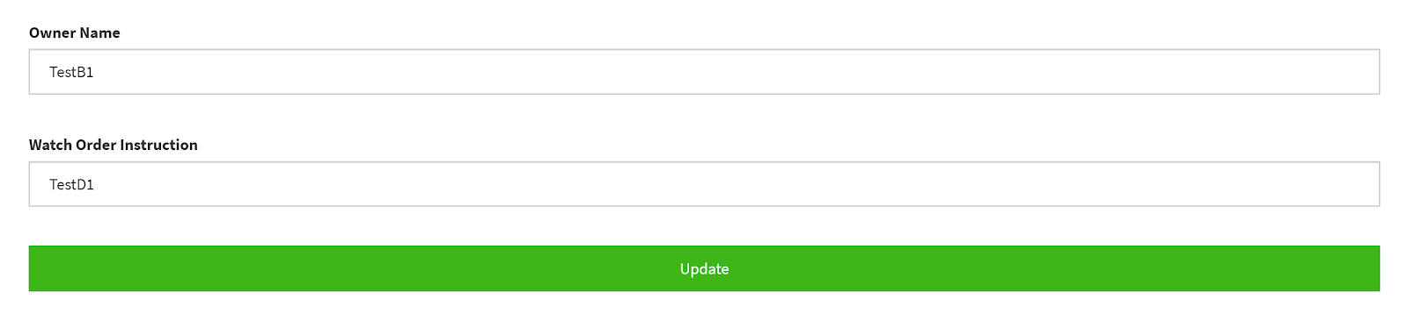

Slide 19
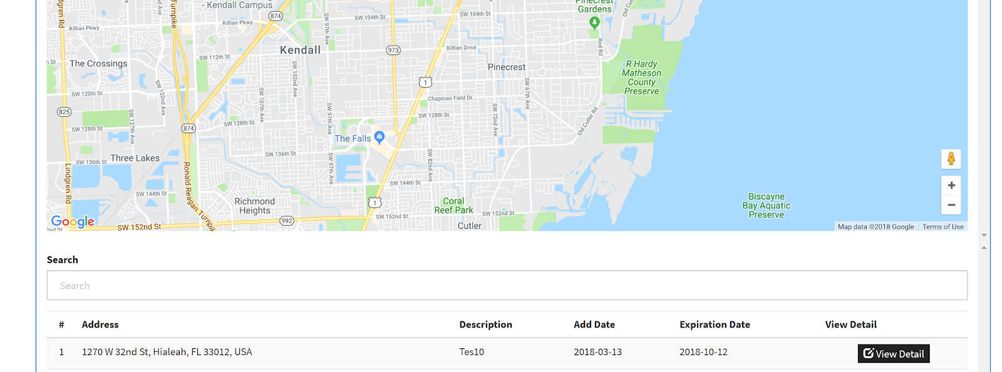

Slide 20
User Story #336
Improve User Login
As a user, I would like to be prompted to log in when I open a new browser window so that other users cannot access unauthorized information.
Acceptance Criteria:
When users try to access the application using a URL that contains a specific resource Ex: app/users, the application needs to verify that a section is currently active.
If user is not logged in, redirect user to log in screen.
If section is created and active proceed with rendering the response to the resource.
Notes:
20 seconds
The tile of user story
Please present and show the complexity of your work, code, algorithms, and technical challenges and technologies you have used. (you could use screenshot if you want. Visual presentations are better than text presentation) - Go into the details of the most important/significant tasks using bullet lists or visual graphs or state chart diagram - Demo using screenshots or GIF (in another separate page if required)
Sequence Diagram for this user story is optional

Slide 21
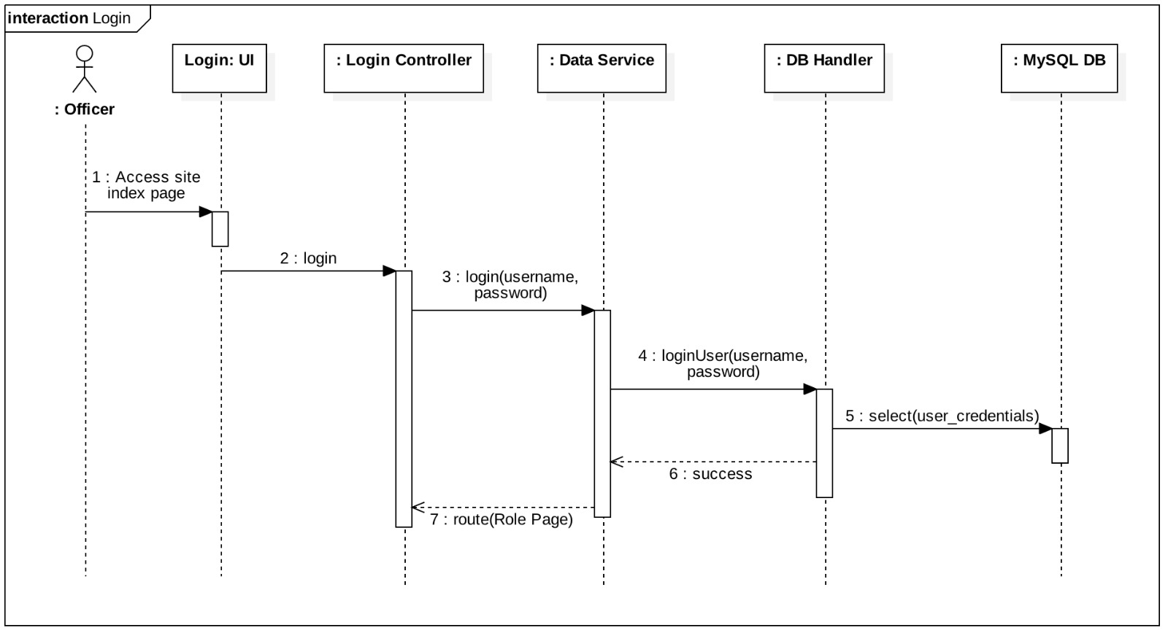
Notes:
20 seconds
The tile of user story
Please present and show the complexity of your work, code, algorithms, and technical challenges and technologies you have used. (you could use screenshot if you want. Visual presentations are better than text presentation) - Go into the details of the most important/significant tasks using bullet lists or visual graphs or state chart diagram - Demo using screenshots or GIF (in another separate page if required)
Sequence Diagram for this user story is optional

Slide 22
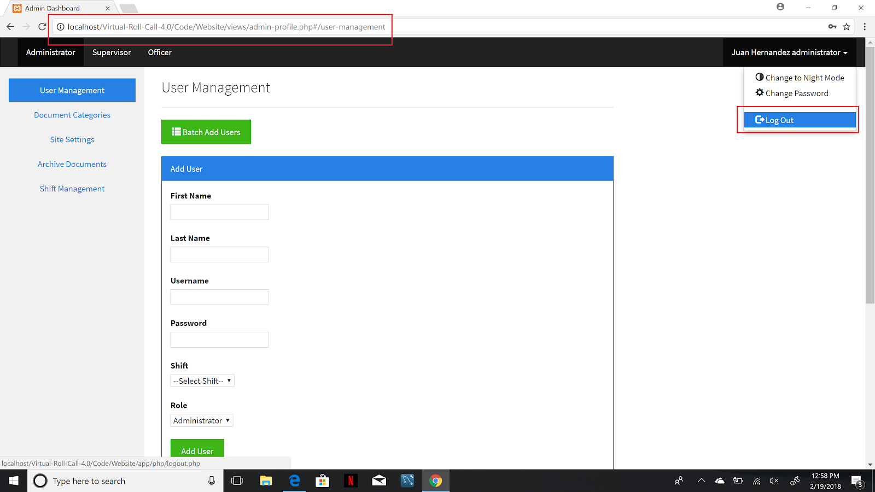

Slide 23
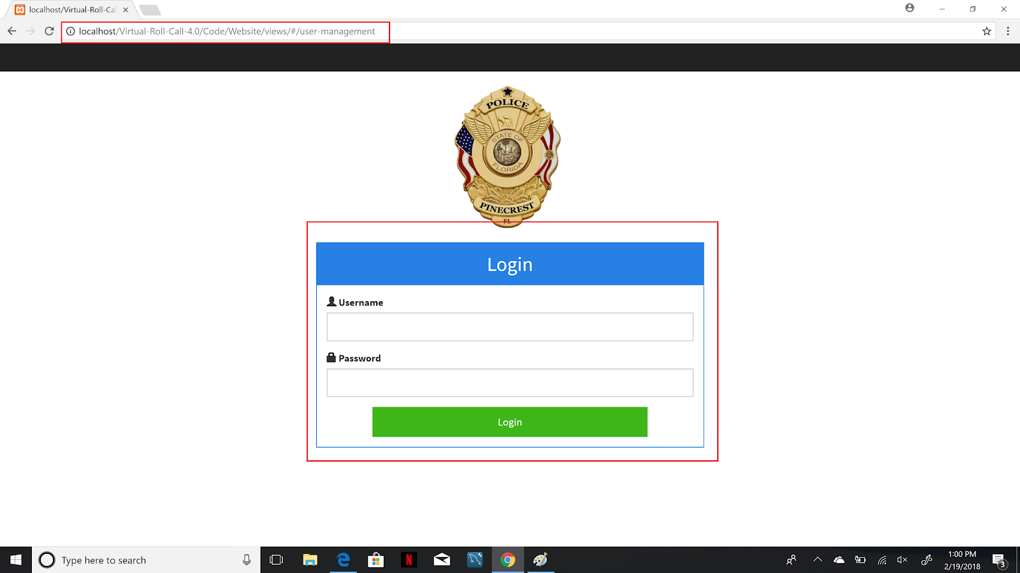

Slide 24
User Story #341
Archive Only “Done” Documents
As a user I would like to see that all “Done” documents to be archive so that I can only see in the folder “Pending” or “Reviewed”
Acceptance Criteria:
Archive only the documents with status “Done”.
Documents must be older than 7 days.
Notes:
20 seconds
The tile of user story
Please present and show the complexity of your work, code, algorithms, and technical challenges and technologies you have used. (you could use screenshot if you want. Visual presentations are better than text presentation) - Go into the details of the most important/significant tasks using bullet lists or visual graphs or state chart diagram - Demo using screenshots or GIF (in another separate page if required)
Sequence Diagram for this user story is optional

Slide 25
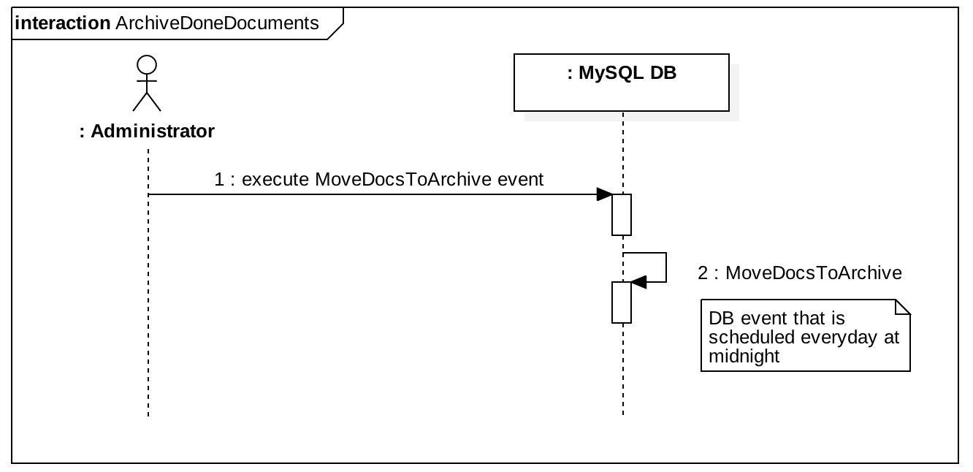

Slide 26
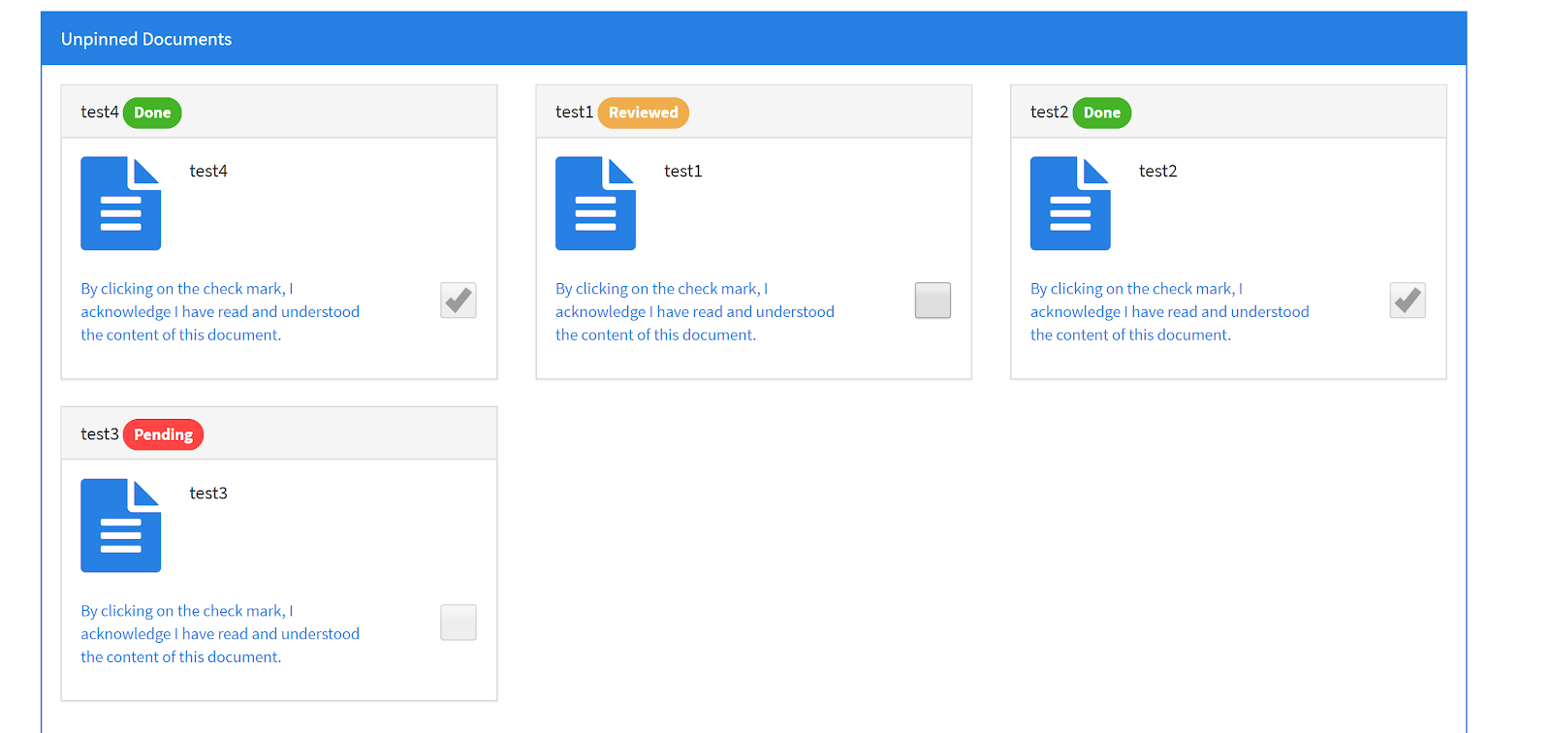
Before running MySQL event.

Slide 27
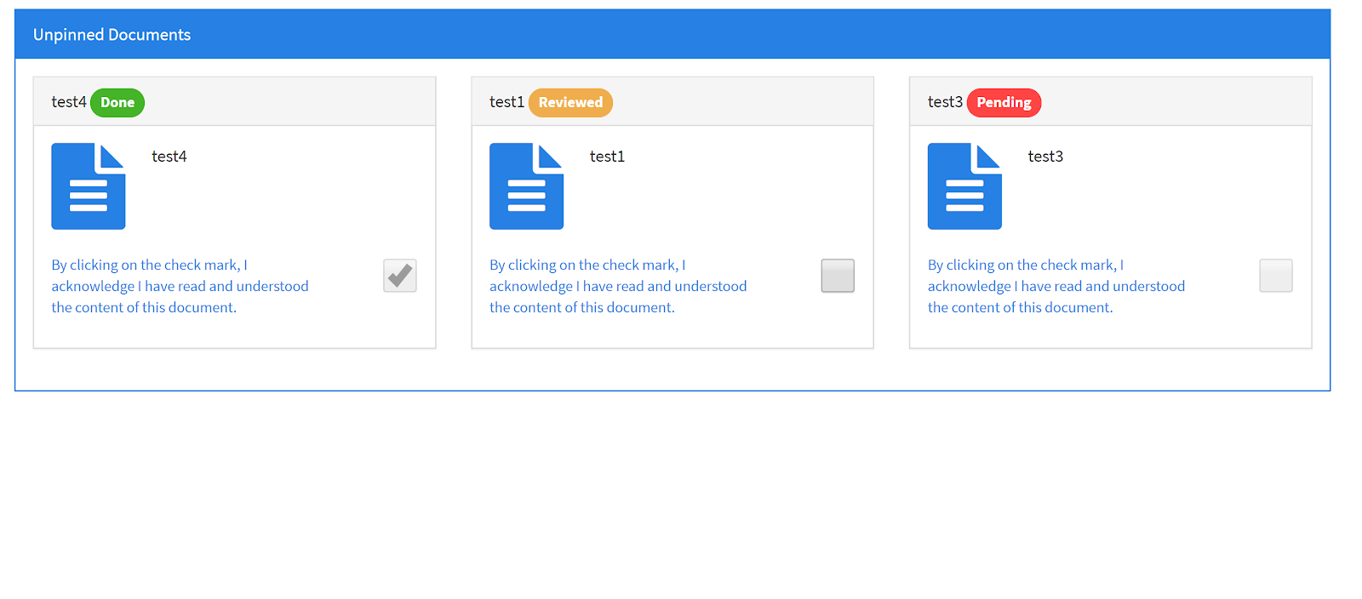
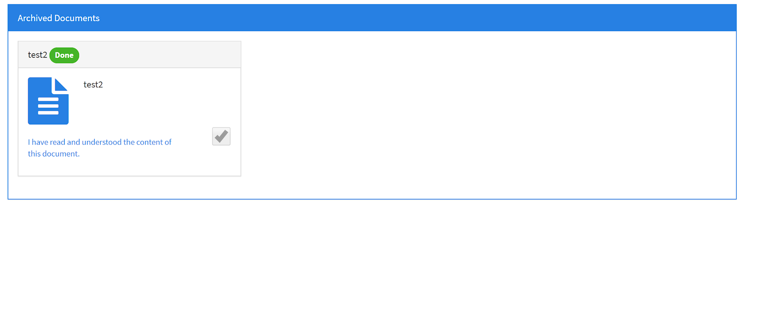
After running MySQL event.

Slide 28
User Story #342
Open Document Viewer has to be Defaulted to Fit to Screen
As a user I would like to see the documents, which are opened in the document viewer, to fit the viewer screen, so that I can see them clearly the first time I open them.
Acceptance Criteria:
Open documents with the “fit to screen” property set

Slide 29
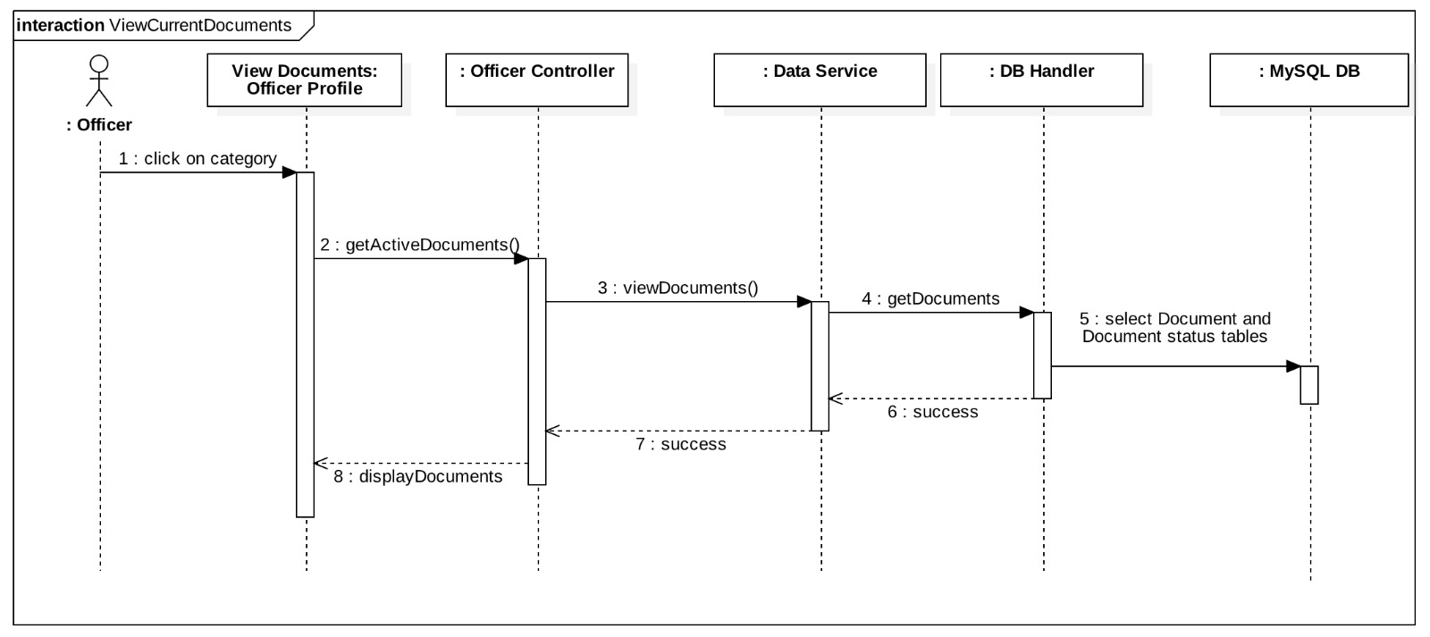

Slide 30
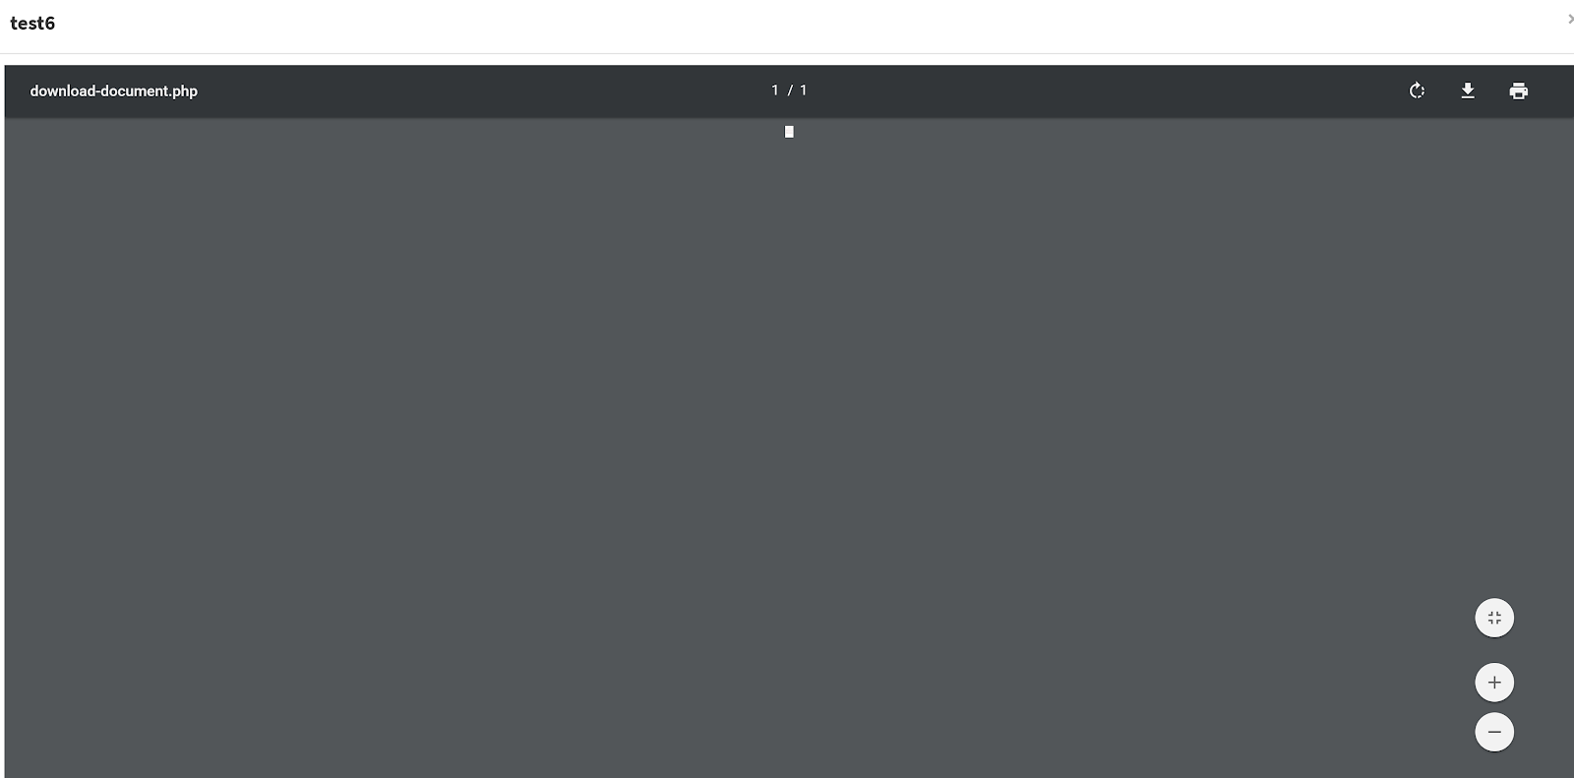
Before code fix

Slide 31
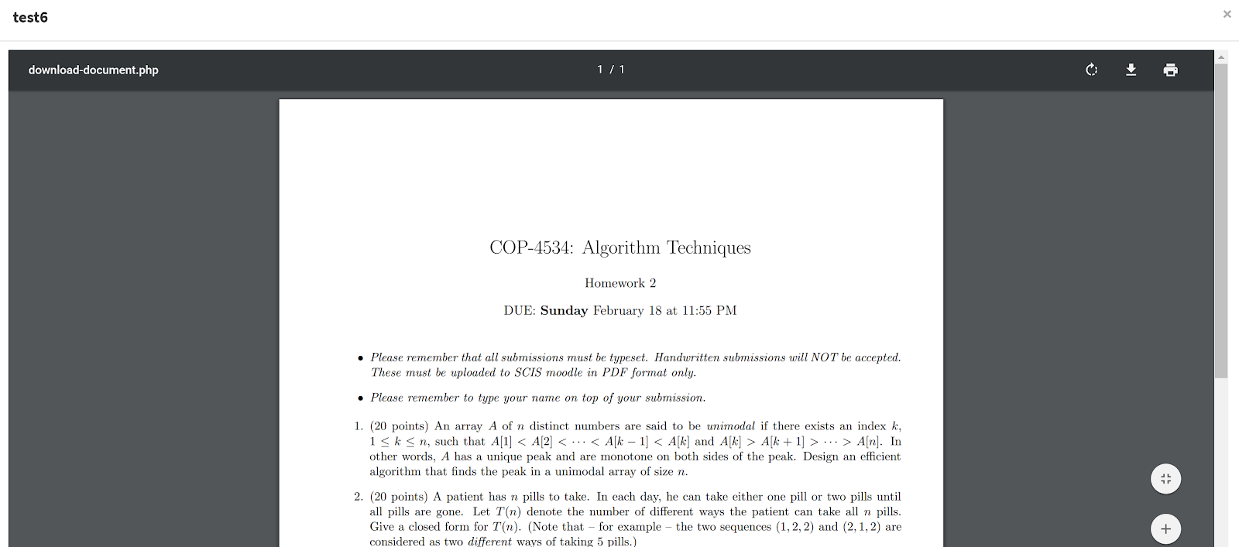
After code fix

Slide 32
Test Suites and Test Cases
Test Case ID | User Story #331 Keep Track of Visited Locations-U1
Purpose | User can mark and unmark locations that have been visited. They also have the ability to unmark them all at once.
Preconditions | User is logged in. User have watch orders in the View Watch Order Screen.
Input | User clicks the watch order to mark as visited.
Expected Output | User was able to mark and unmark the visited locations and the user was also able to unmark them all.
Actual Output | Supervisor was able to save all the data just like it would write it on the original document.
Status | Pass
Notes:
10 seconds
A description of verification process and Test Suites and Test Cases for one of the use cases.
1 One sunny day and one rainy day for the implemented use cases (one or more slides).
2 Automated test scripts for the implemented use cases (if any) (one or more slides).

Slide 33

Summary
Ability to track visited locations.
Ability to archive “Done” documents.
Improve Watch Order Form.
Ability for Officers to see the person responsible for creating Watch Orders
Improve the login and view documents.
Juan Hernandez
Questions?
Thank You!
Notes:
10 seconds
Summarize your contribution, mention your effort for Scrum, Mingle, Github, Google Drive Documentation and minutes
Include your contact information
Ask if anyone has any questions for you.
Thank your audience

